Slide 1
The Sails of Santiago
A Game ProjeB00328251}ct by:
Andrew Letailleur {B00334945}
Kirstin Jackson {
Gary Malcolmson {B00307865}
Notes:
Introduce ourselves individually, with possible Project Manager/leader concluding in this order: “Andrew” > “Kirstin” > “Gary” > “Leader” (And this is our year long project for the Games Development module, Sails of Santiago.)

Slide 2
Outline
Meet the Team
Why this idea?
Inspirations
What Was Used
Game Design
Prototype
What We Have Learned
Credits

Slide 3
Meet the Team
Cause we’re cool!

Slide 4
Meet the Team
Gary
Project Manager
Programmer -
Ports, Main Menu, Ship Upgrades, Cameras.
Andrew
Programmer -
Enemy AI,
Player Navigation &
Combat
Kirstin
Programmer - Characters/Stats/
Inventory/Items
Asset Locator
Powerpoint Creator
Notes:
Introduce each other’s separate professions in visual. So Gary =/= his roles (and explanations if/any.) And the same on my then Kirstin’s end.
Also, uni wise; number the names instead at a minimum. It’s dehumanising, I know. But it’s apparently this university’s standard, I feel.

Slide 5
Why this idea?

Slide 6
Reasons why we choose this game..
This idea was similar to games some of us have played.
A popular theme that has captured imaginations for hundreds of years, and very successfully in games.
A modular design with room for expansion where we find the fun/interest, and can scale back where there isn’t any.
Easy to work as a team relatively separately thanks to this modularity, and with multi-scene editing and prefabs a great deal of freedom to work without merge conflicts is possible.

Slide 7
Inspirations

Slide 8
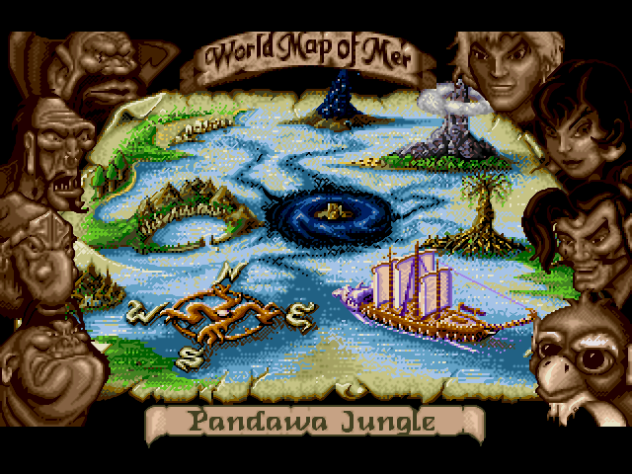
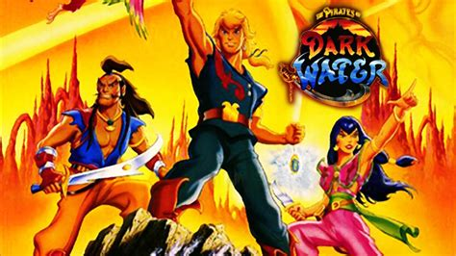
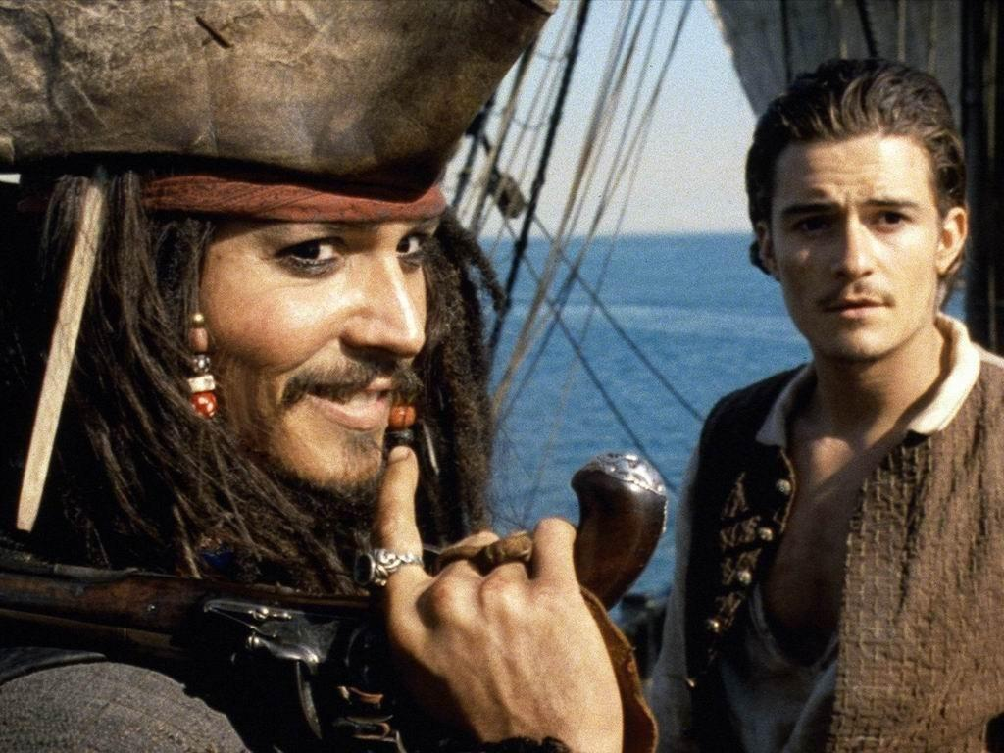

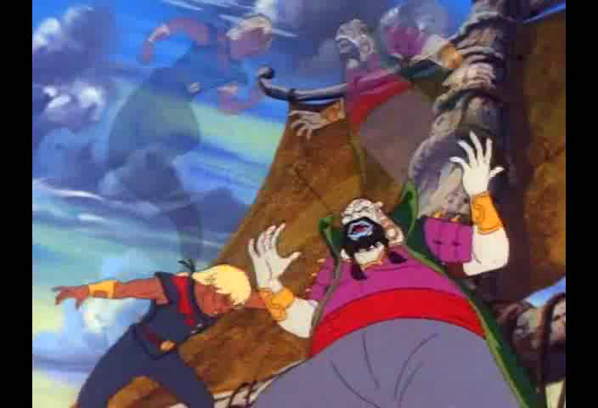
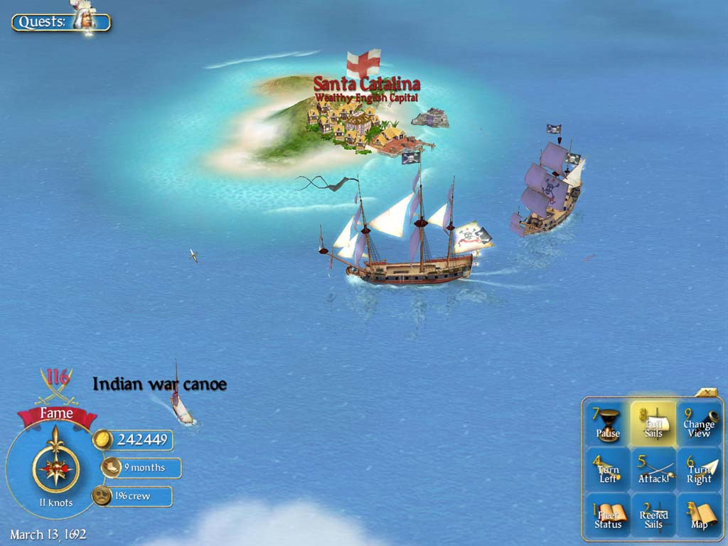
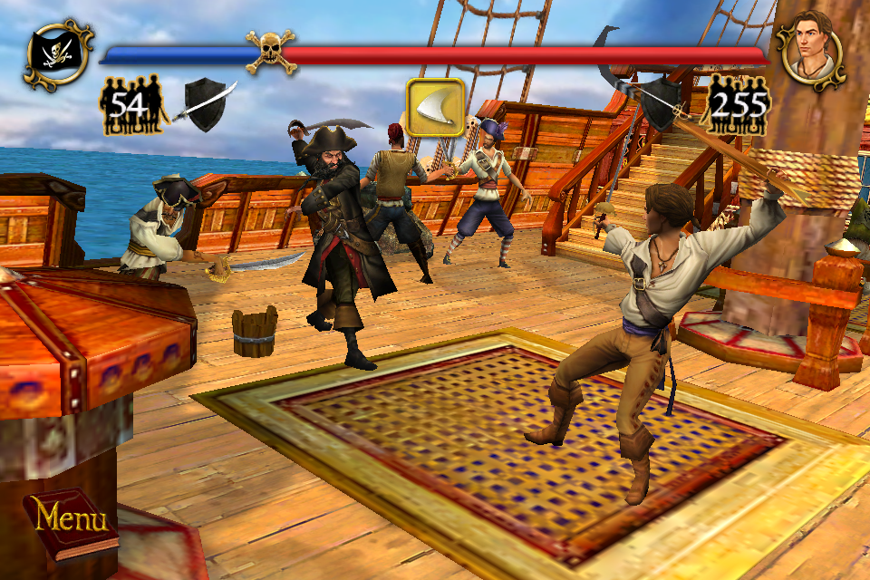
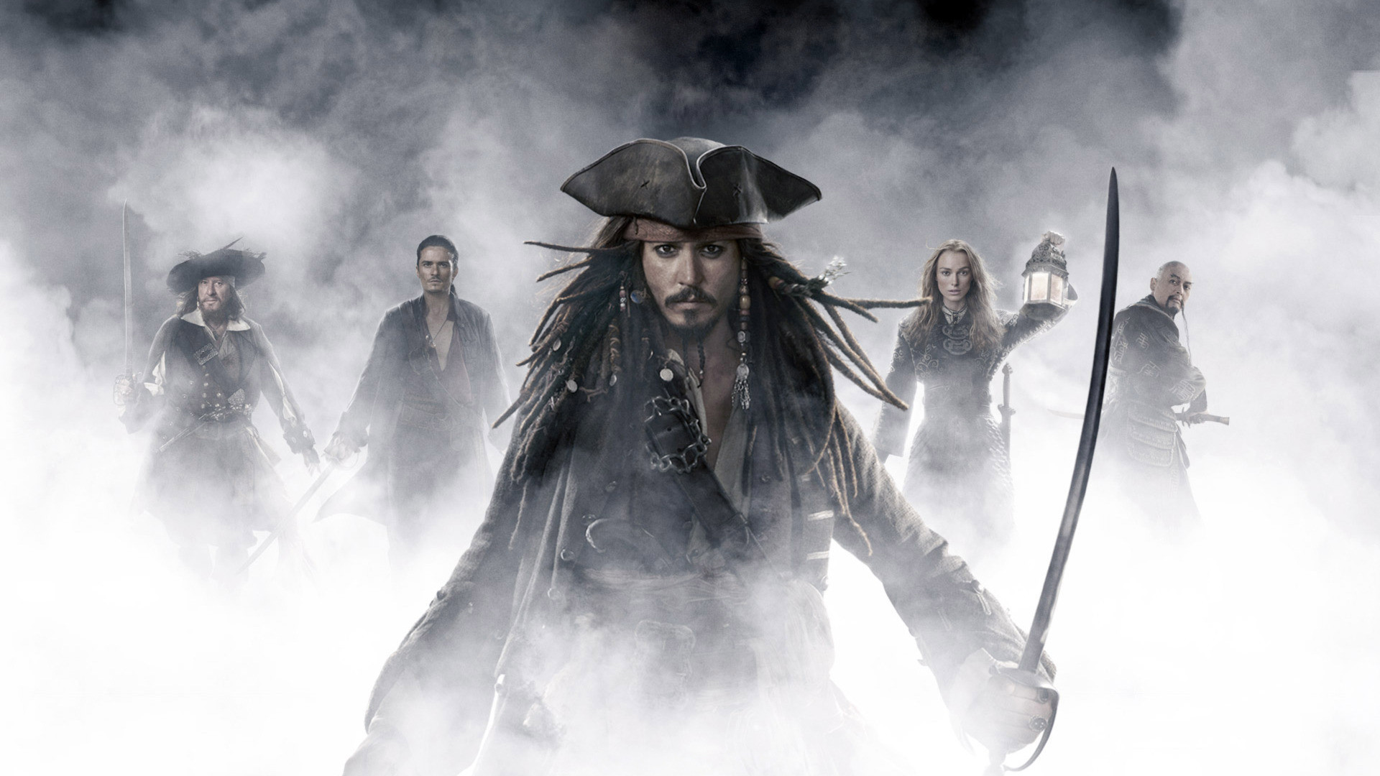
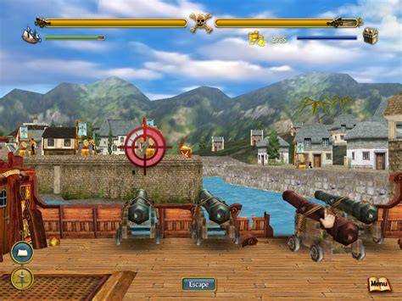
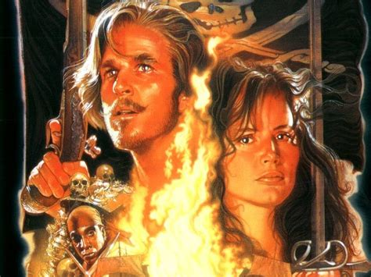
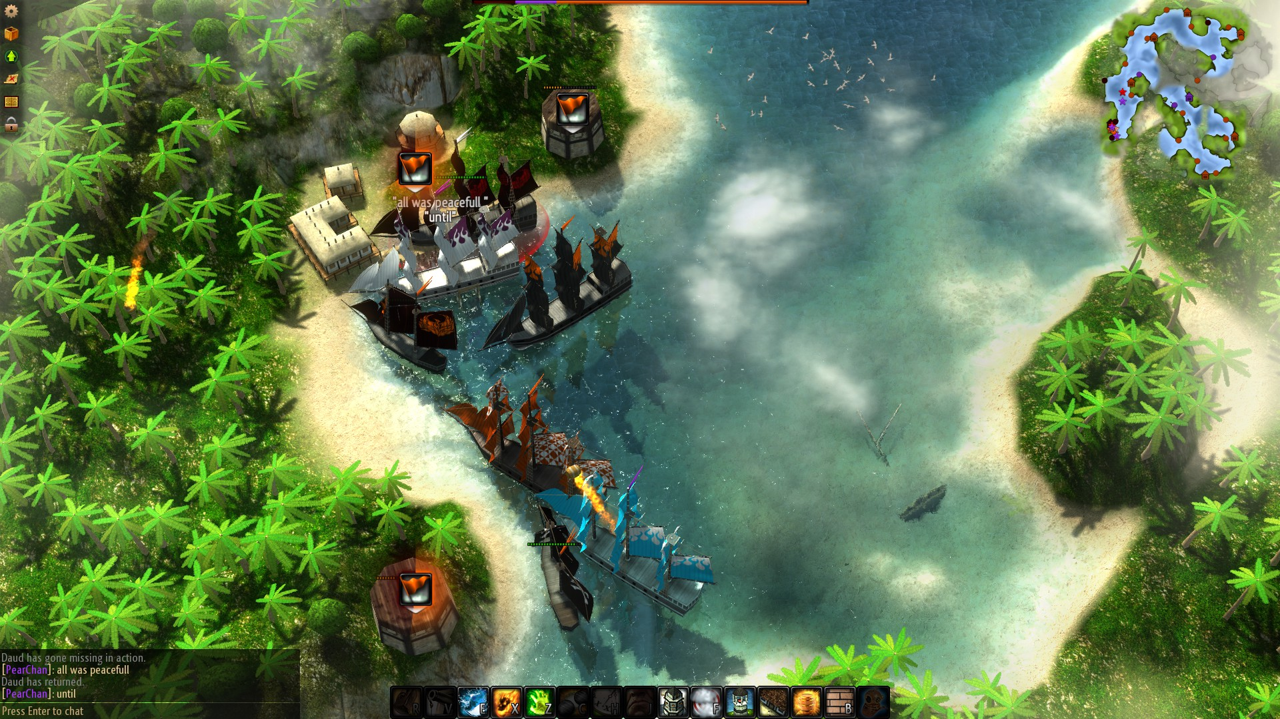
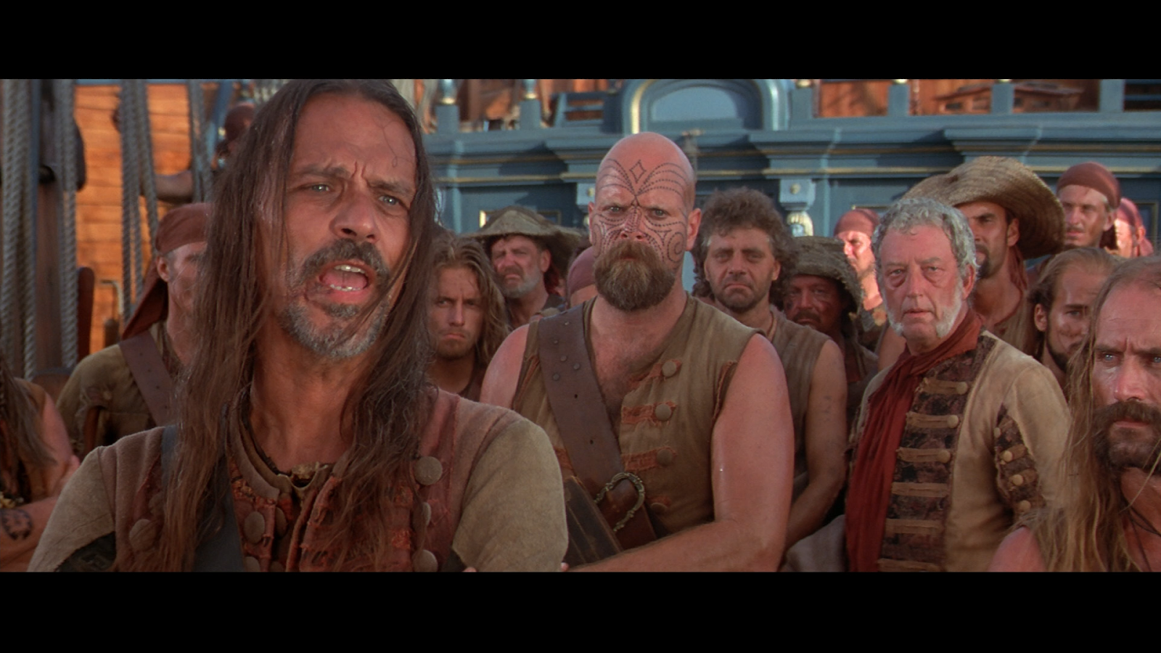
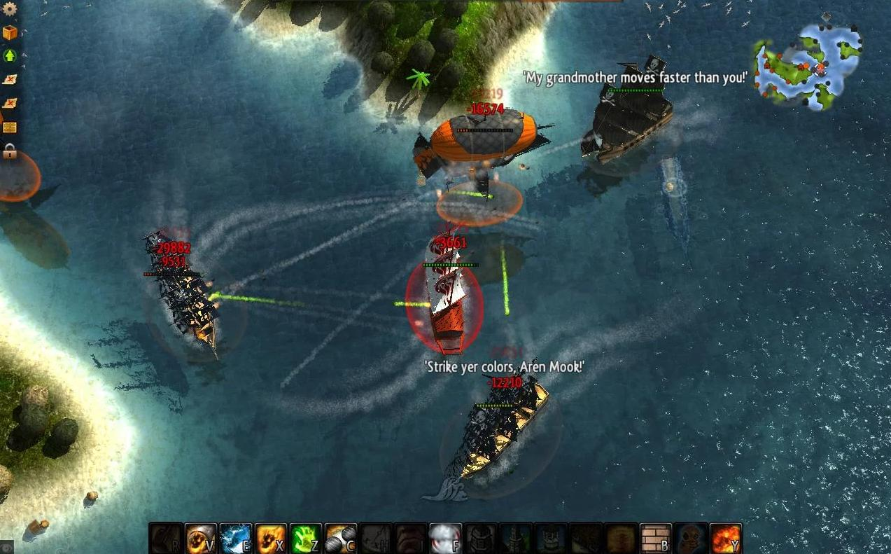
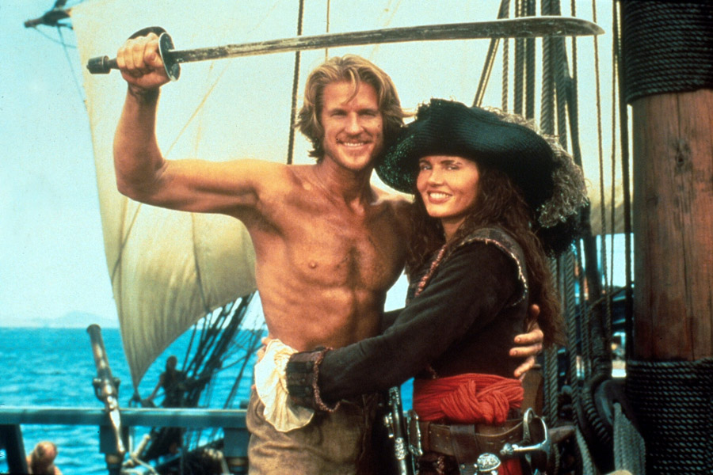
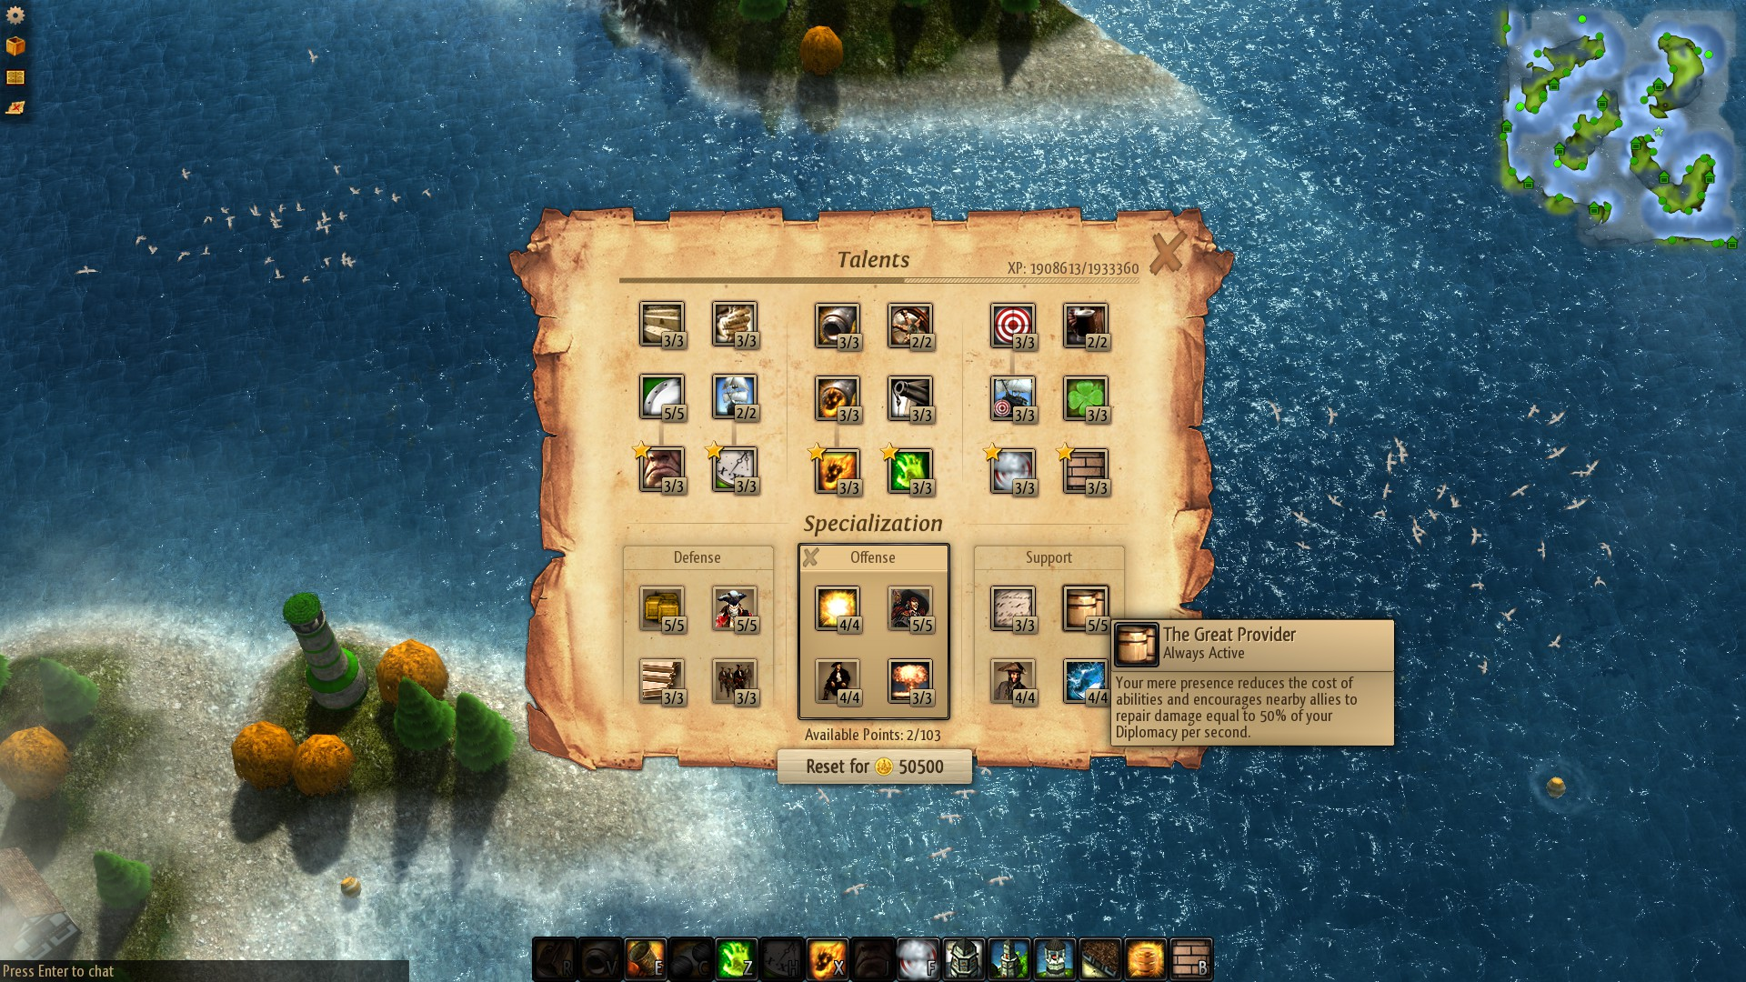
Pirates of Dark Water
Pirates of the Caribbean
Sid Meier’s Pirates
CutThroat Island
Windward
Notes:
Kirstin Covers movies, while Gary covers games. Inspiration wise.

Slide 9
What Was Used

Slide 10





Unity 2018.2.8 f1
Visual Studio 2017
Gimp
Blender
Paint.net
Notes:
Add only what has been used. And Store Assets count as Unity, not strictly Blender, though it could be a listed source; since all those models have to come somewhere… -AIL

Slide 11
Game Design

Slide 12
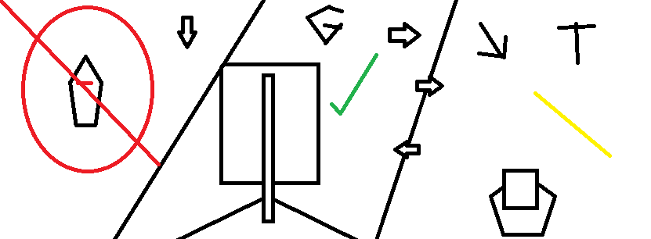
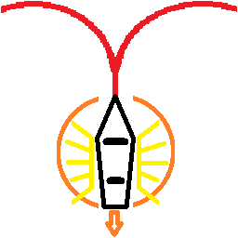

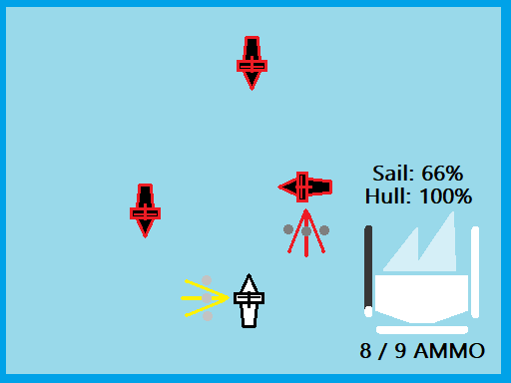
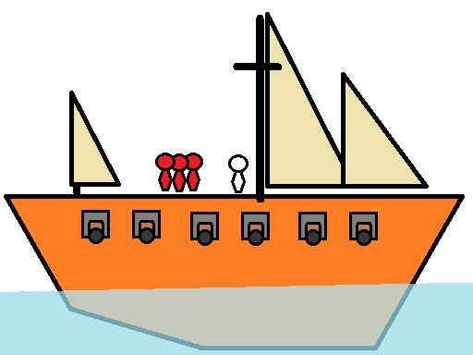
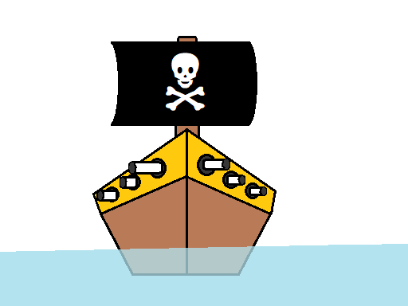
Sketches, Designs, etc
Notes:
Andrew - I will cover the sketch aspect. List the features that work.

Slide 13
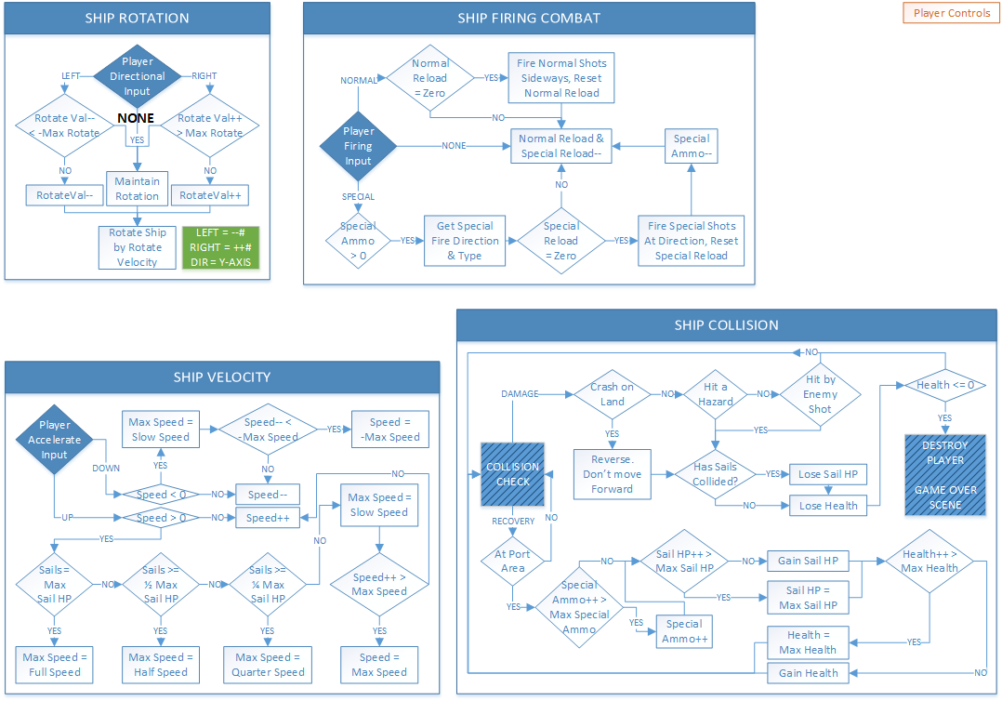
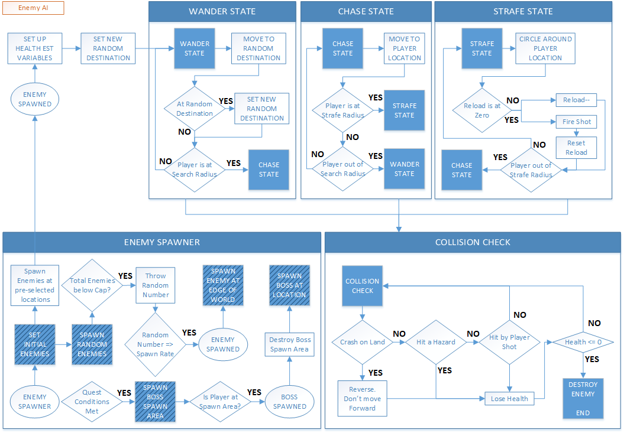
Sketches, Designs, etc (cont)

Slide 14
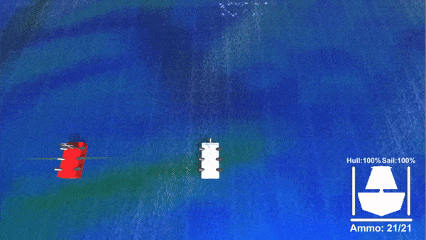
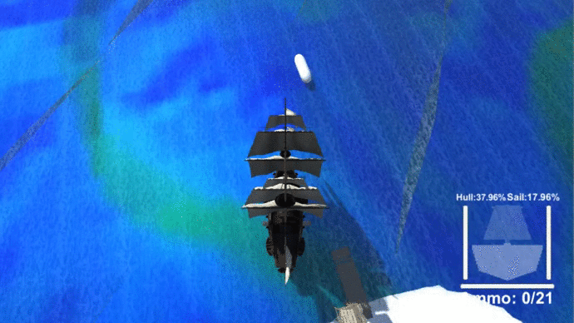
Early Gameplay Samples
Notes:
Gary - List the port functionality, after I’ve finished covering for enemy AI (AIL)

Slide 15
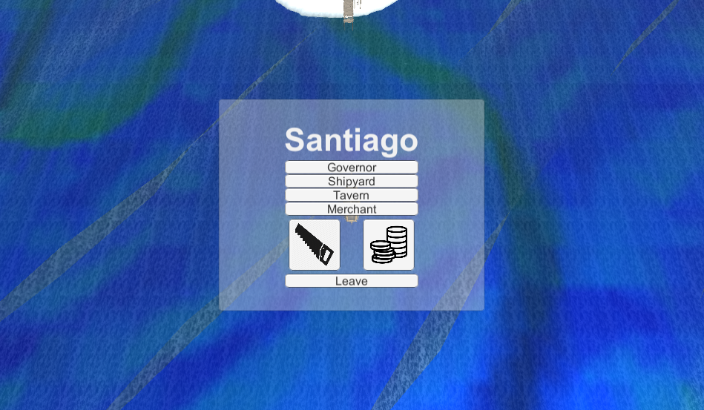
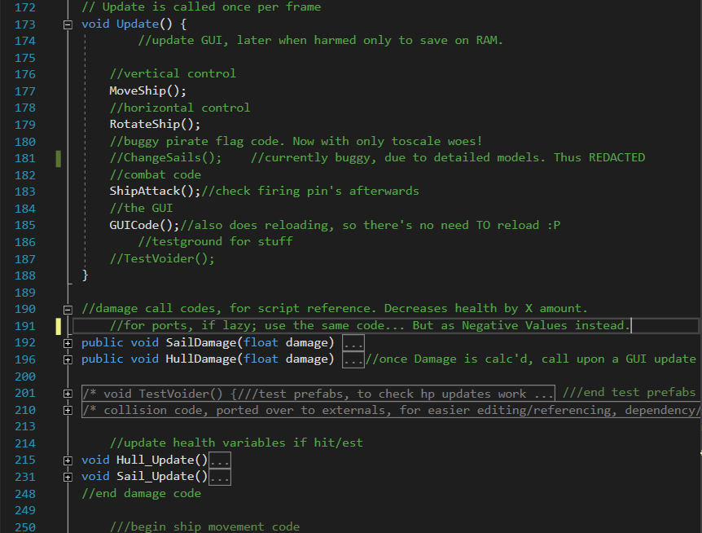
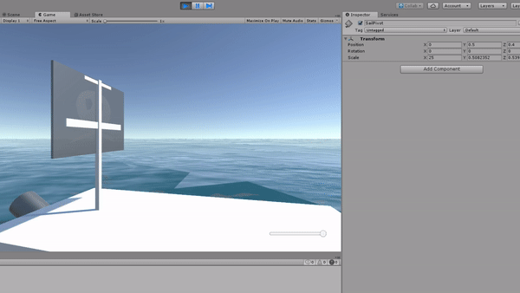
Some WIP Features
Code Excerpt/Example?
Notes:
Andrew - I cover the sail and current state of game code, AI/Player wise.
Gary - Can cover the ‘sail port’ aspect, and may possibly go “thanks Andrew?” Over vlaues resettnng themselves if hit/hugged by an enemy.

Slide 16
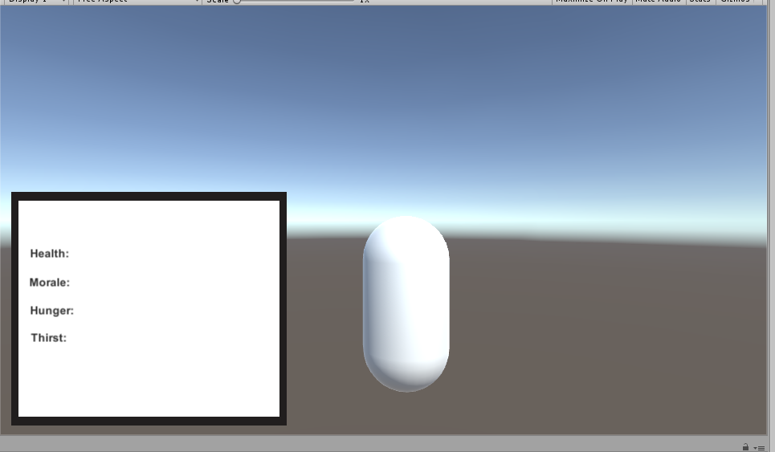
Crew will have stats that have an effect on play.
Starting small with some basic health, hunger, thirst & morale.
Can be expanded with additional stats.
NPCs may be able to benefit from their own crews!
Start of the player stats
Notes:
Kirstin can deal with this.

Slide 17
Protype

Slide 18


The Prototype
Notes:
Make a back up plan in case online video doesn’t work - AIL

Slide 19
What We Learned

Slide 20
What Was Learned
Gary
C# Interfaces. “Interfaces, Interfaces, Interfaces.”
Unity Collab, Multi-Scene Editing & Co-Routines (and where I might not use them).
Unity UI: How poorly it is documented, and how important it is to find this out sooner.
AIL / b00334945
Sharing / Collaborating on the same Unity project (via the cloud)
Better AI programming
Video to Gif conversion
Prototyping
Creating an inventory/stats system
Collaborating through the Unity cloud
Learning better communication skills
Notes:
Talk about our lessons learnt individually; from left/right order.

Slide 21
Questions?

Slide 22
References
https://answers.unity.com/questions/index.html
https://forum.unity.com/#unity-community-discussion.4 < For programming issues
https://www.reddit.com/r/Unity3D/
https://www.desmos.com/calculator/cctb9rqruw < Math calcs for initial ‘strafing’ code, reference wise
Notes:
Andrew - I cover the short reference links due to familiarity.

Slide 23
Image references
Pirates of the Caribbean:
https://www.hdwallpapers.in/walls/pirates_of_the_caribbean_movie-HD.jpg
http://4.bp.blogspot.com/-KU-rpTBH_2A/TaVCfD4_5qI/AAAAAAAAABI/psjdZjAj8p0/s1600/Pirates_Of_The_Caribbean_015-748865.jpg
http://3.bp.blogspot.com/-l6dsqZGbiYs/TZpzpwor-EI/AAAAAAAAAAg/IXW0uTmrIc0/s1600/1287546391_1024x768_pirates-of-the-caribbean-photos.jpg
CutThroat Island:
https://i.ytimg.com/vi/yj8wfyo3Hf4/maxresdefault.jpg
http://2.bp.blogspot.com/-OoIgjrOdGio/Udmt4wr_0MI/AAAAAAAAhbo/MkZ9wCm2bpA/s1600/Cutthroat+Island+5.png
http://g-ecx.images-amazon.com/images/G/01/dvd/lionsgate/Cutthroat_2_lg._V219329202_.jpg
Windward:
http://static1.gamespot.com/uploads/original/1197/11970954/2804469-ss7.png
https://www.android.gs/wp-content/uploads/2015/08/Windward.jpg
https://www.gamegrin.com/assets/games/windward/screenshots/windward-screenshot-7.jpg
Sid Meier’s Pirates:
https://2k.com/en-US/game/sid-meiers-pirates/
https://www.cdrinfo.com/Sections/Articles/Sources/Pirates!/Images/Pirates_sea_large.jpg
Pirates of Dark Water:
https://2.bp.blogspot.com/-pkZkqvBZBbU/WP1NXP4-E4I/AAAAAAAAHjo/8tOfbVWm1jsyZo5WnE74Nwo-pE2NJNFDQCLcB/s1600/PoDW-20.png
https://i.ytimg.com/vi/hFrOZZ1lN-A/maxresdefault.jpg
http://gamefabrique.com/storage/screenshots/genesis/pirates-of-dark-water-02.png

